Slide 1

relationship between a stock’s price and news Or Adventures in Data Acquisition and Cleaning

Slide 2
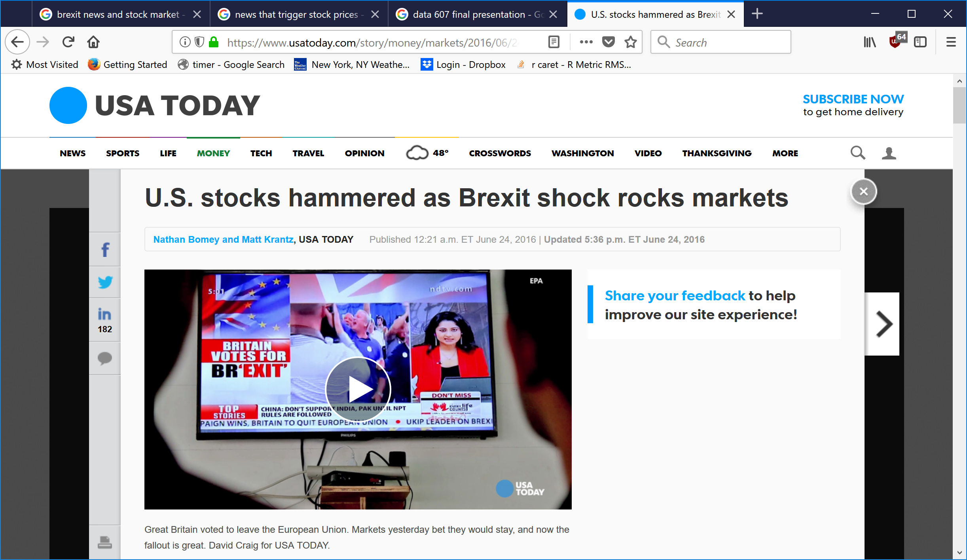
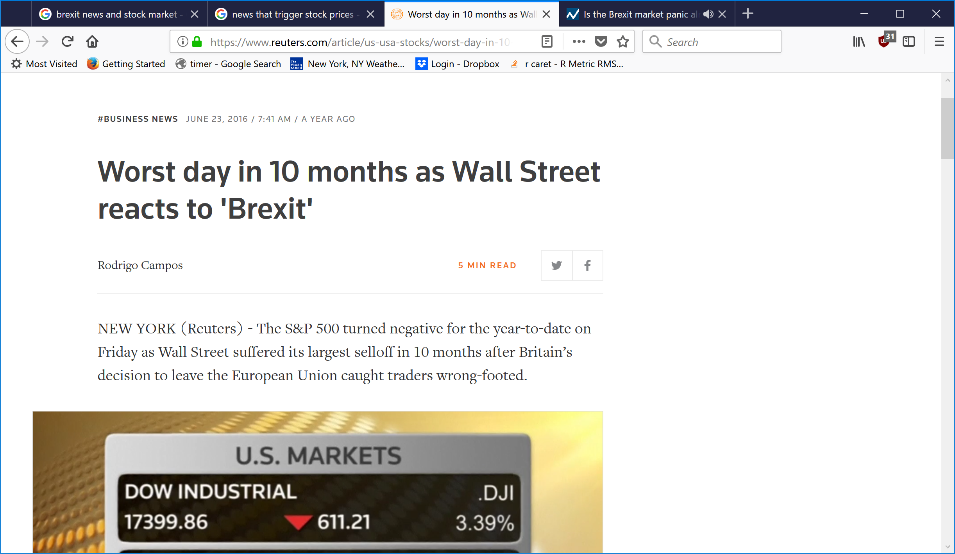
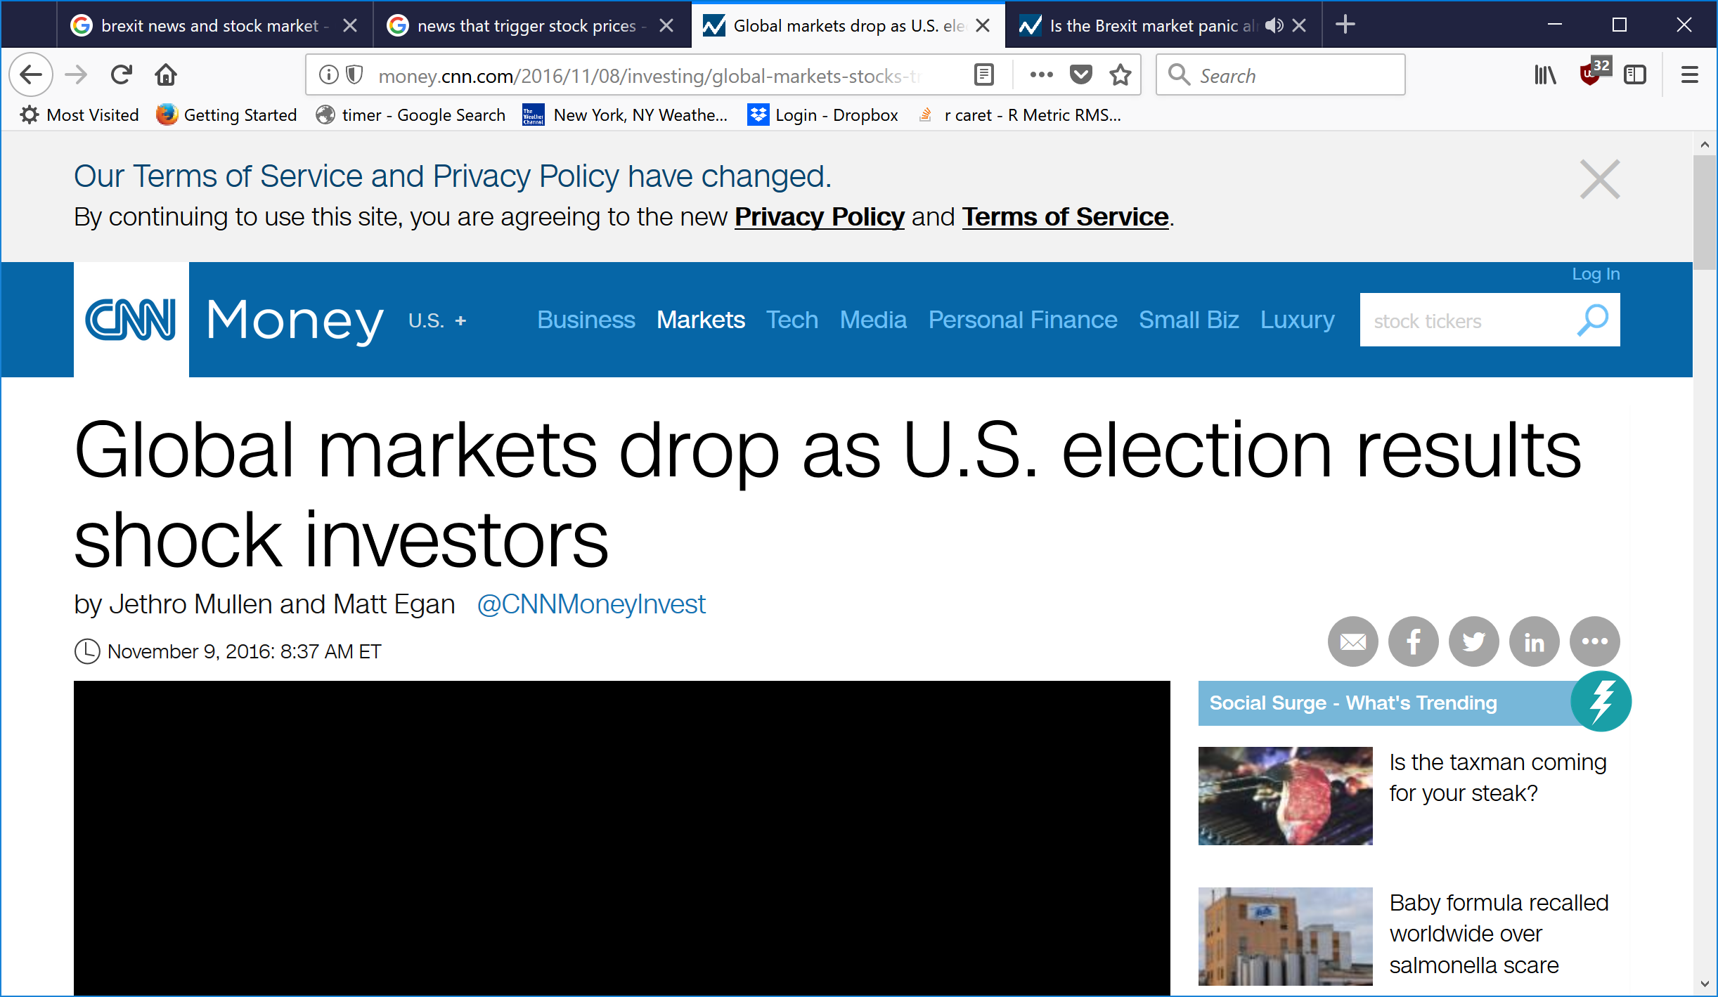
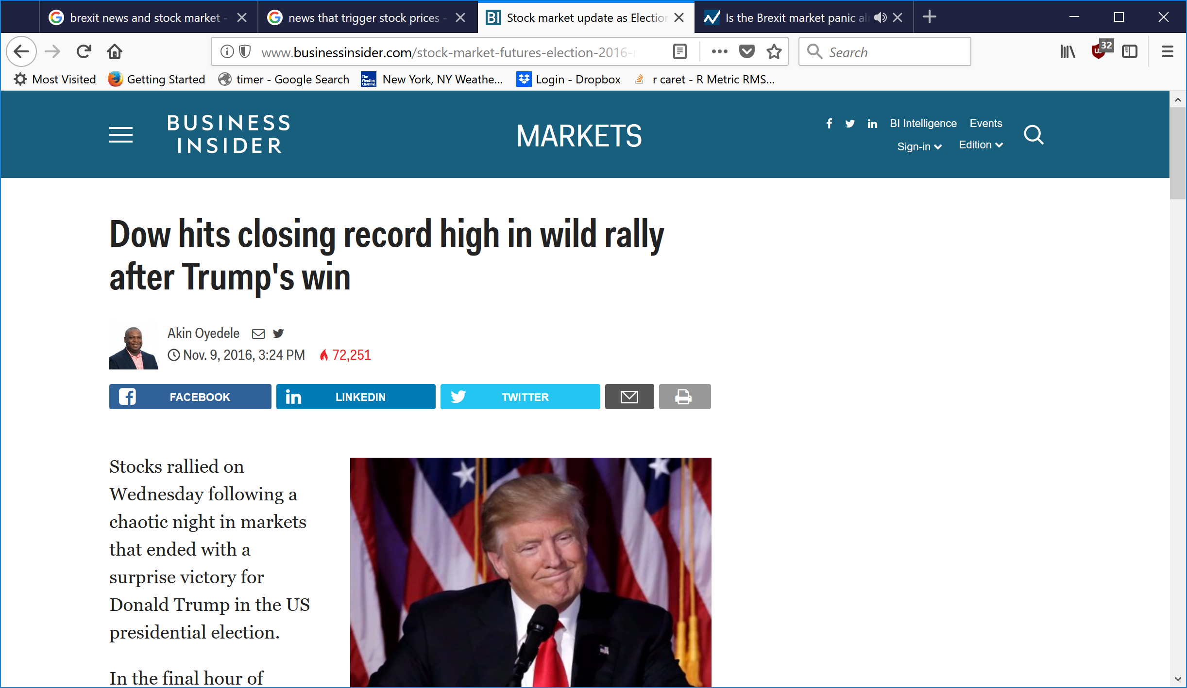

Slide 3
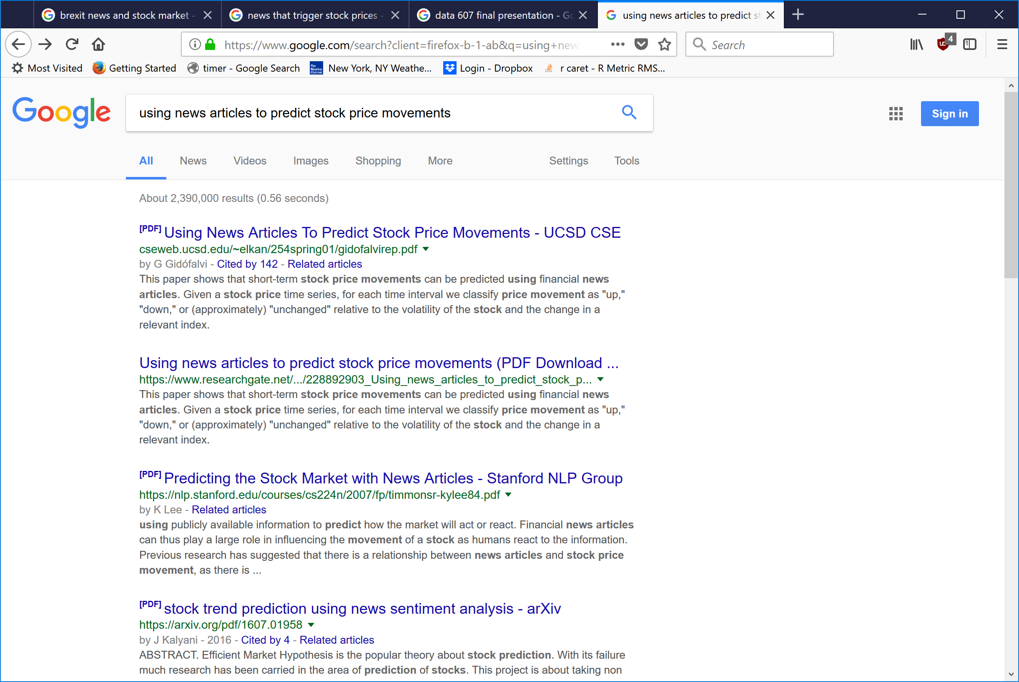

Slide 4
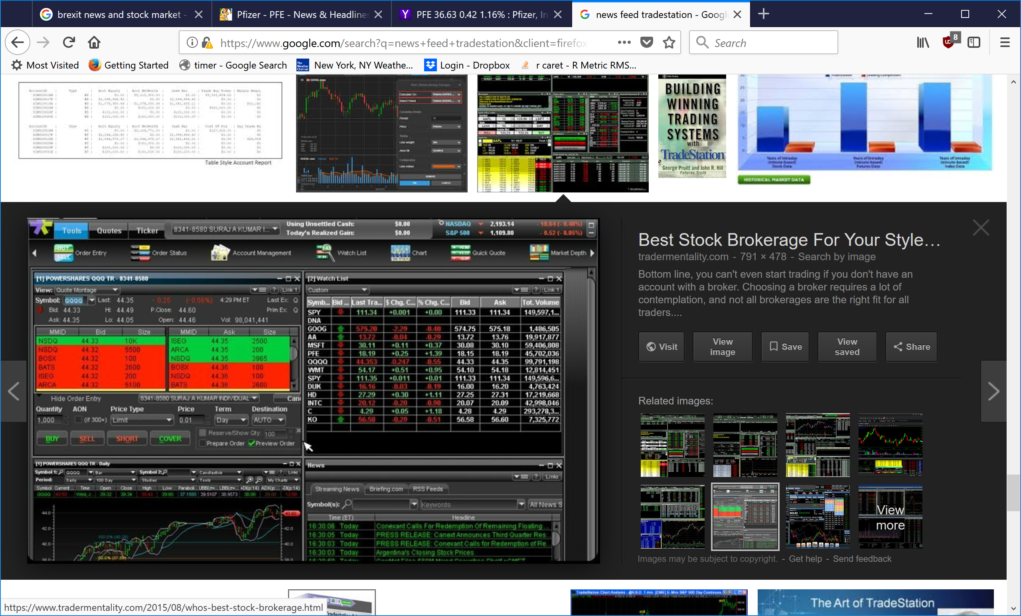

Slide 5
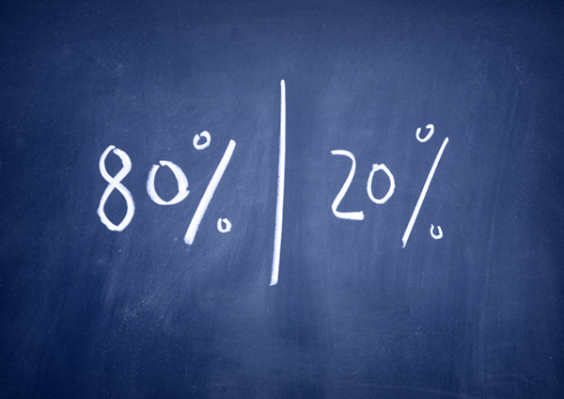
According to the 80/20 rule of data science, 4 days of each business week is spent on gathering data, while only one is spent on running algorithmic models.

Slide 6


Slide 7
Data is expensive
In terms of cost of raw data and time spent locating, aggregating and negotiating with suppliers

Slide 8
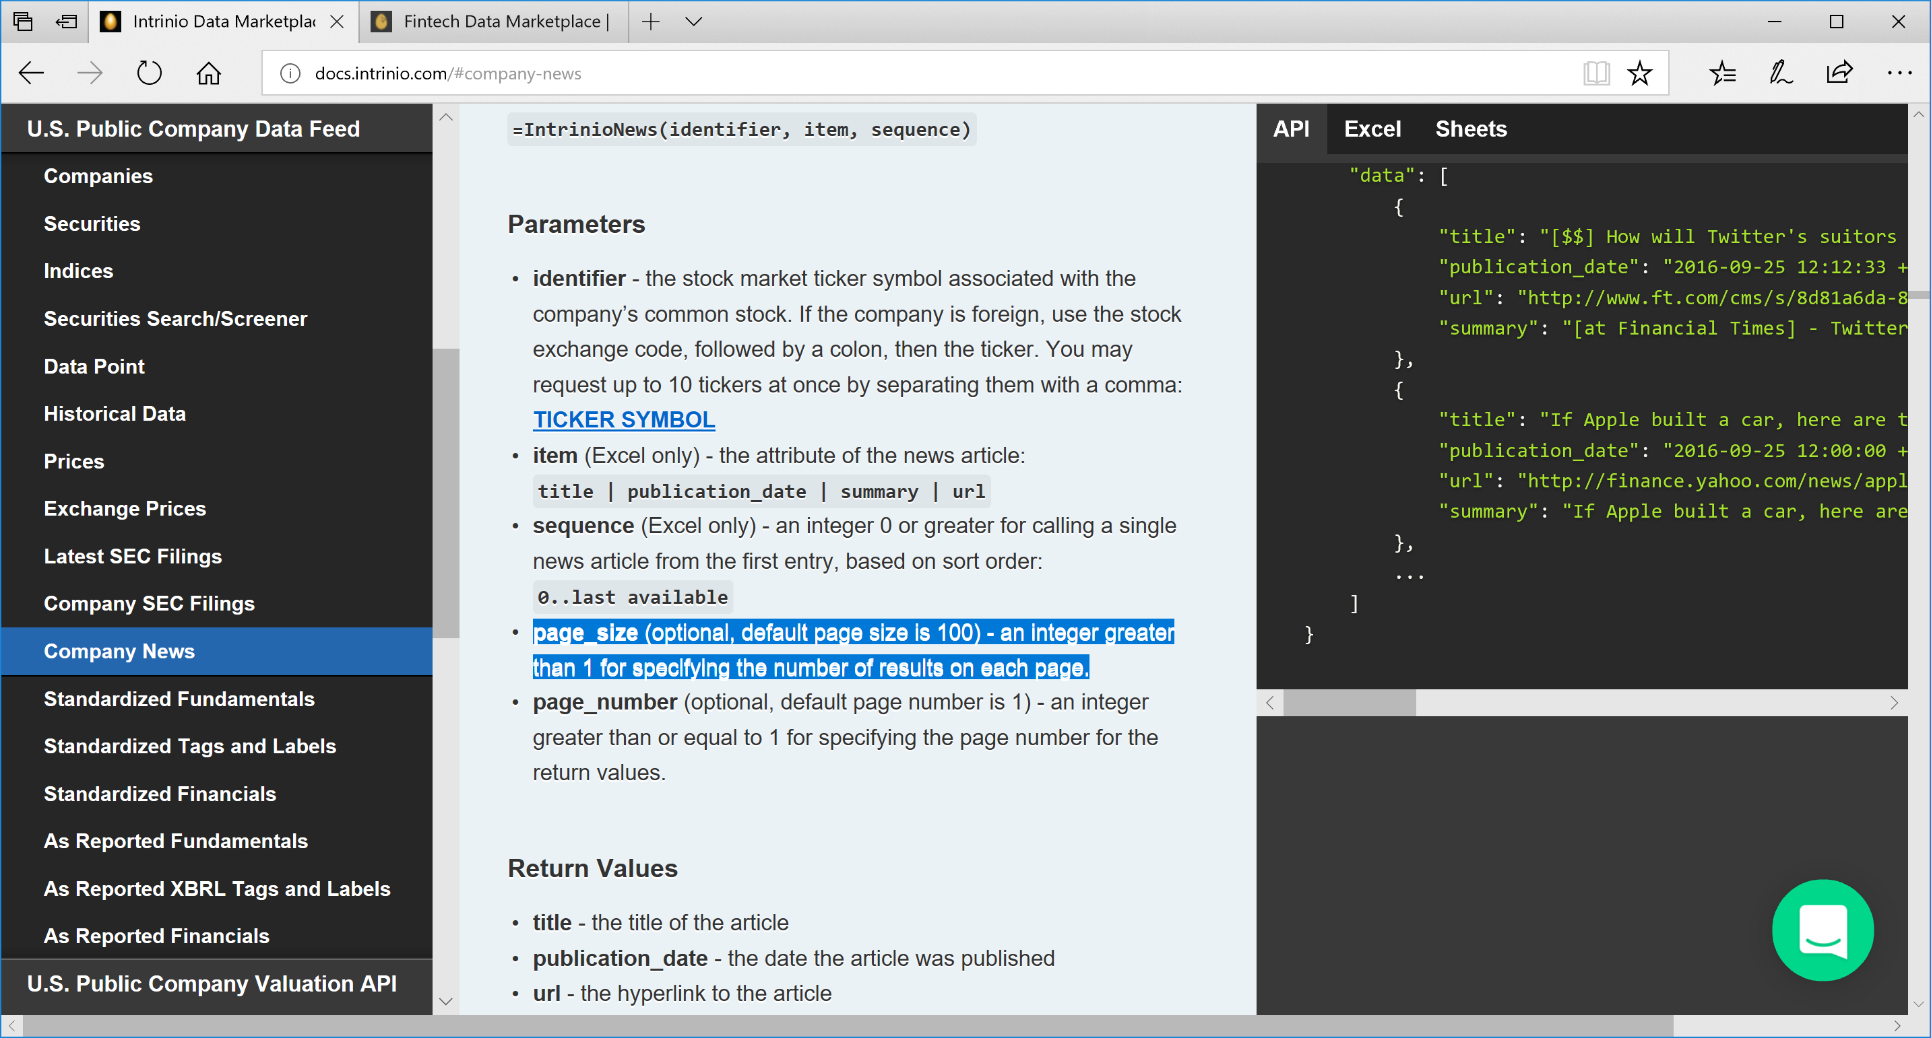

Slide 9
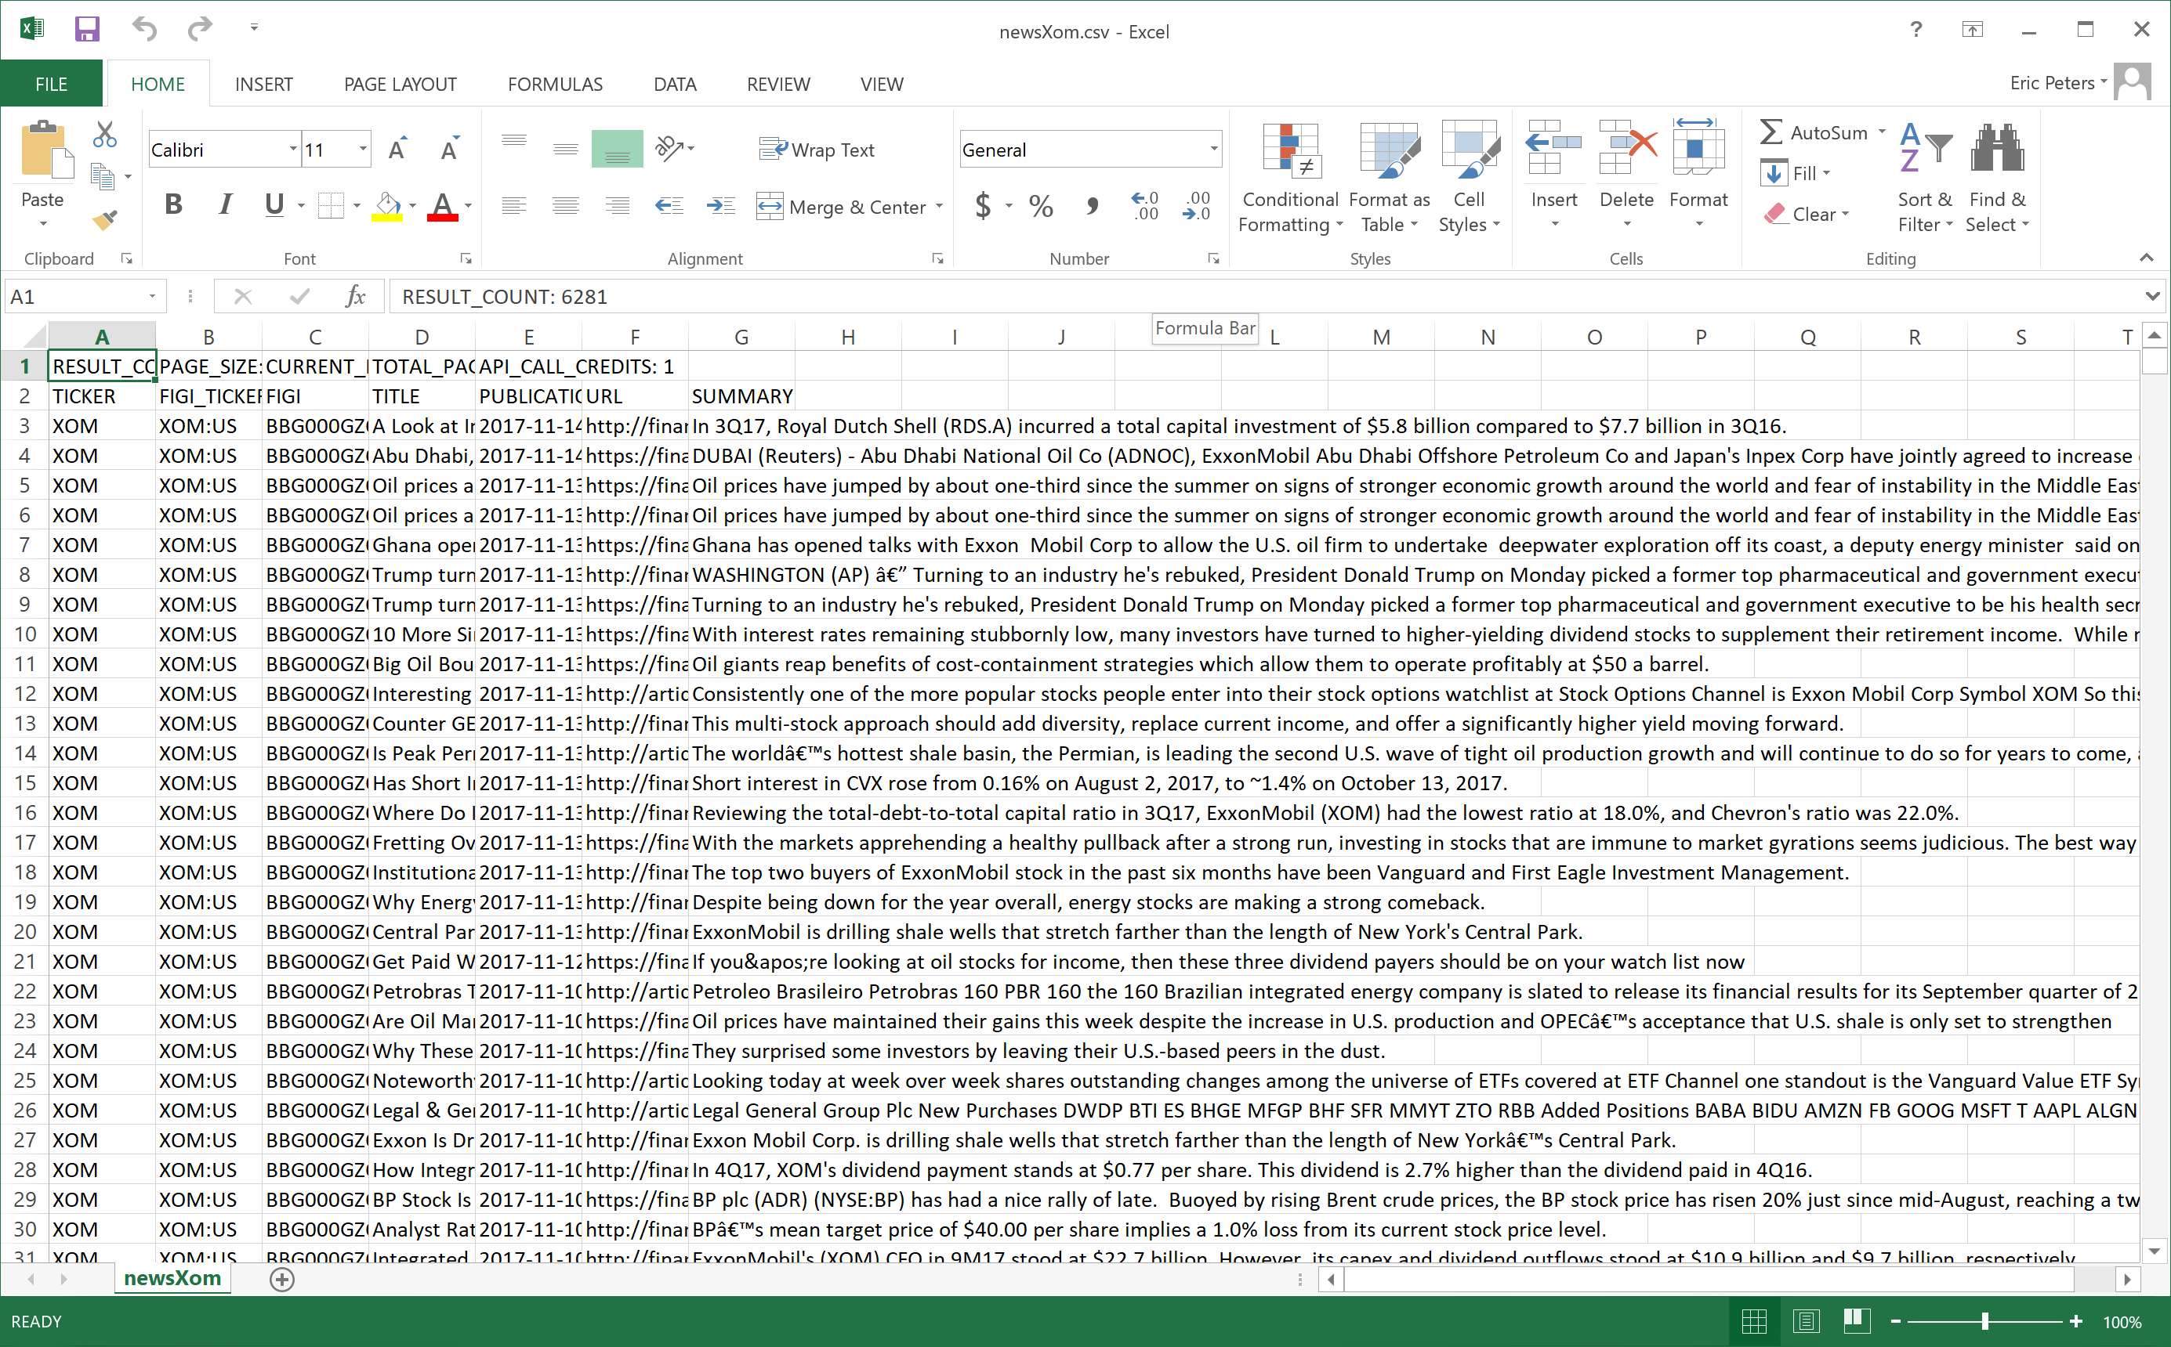
Sample news item

Slide 10
Data is messy
Turning to an industry he's rebuked, President Donald Trump on Monday picked a former top pharmaceutical and government executive to be his health secretary. If confirmed, Alex Azar would oversee a $1 ...\n\n
BPâ€™s mean target price of $40.00 per share implies a 1.0% loss from its current stock price level.
\n
\n
\t\t\t\t\t\t

Slide 11
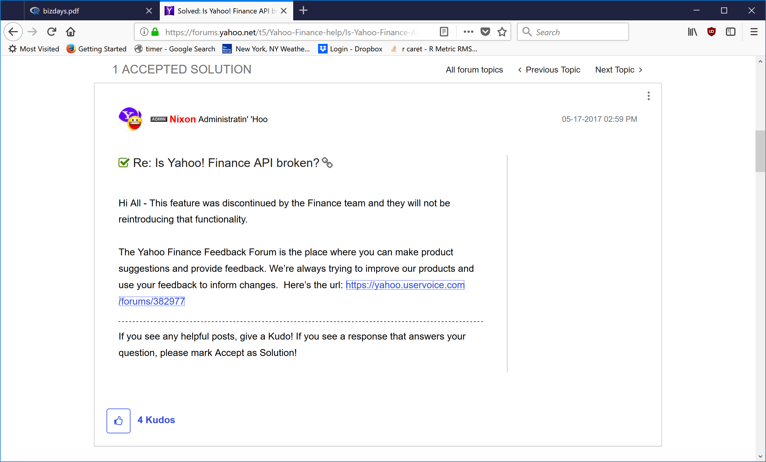

Slide 12
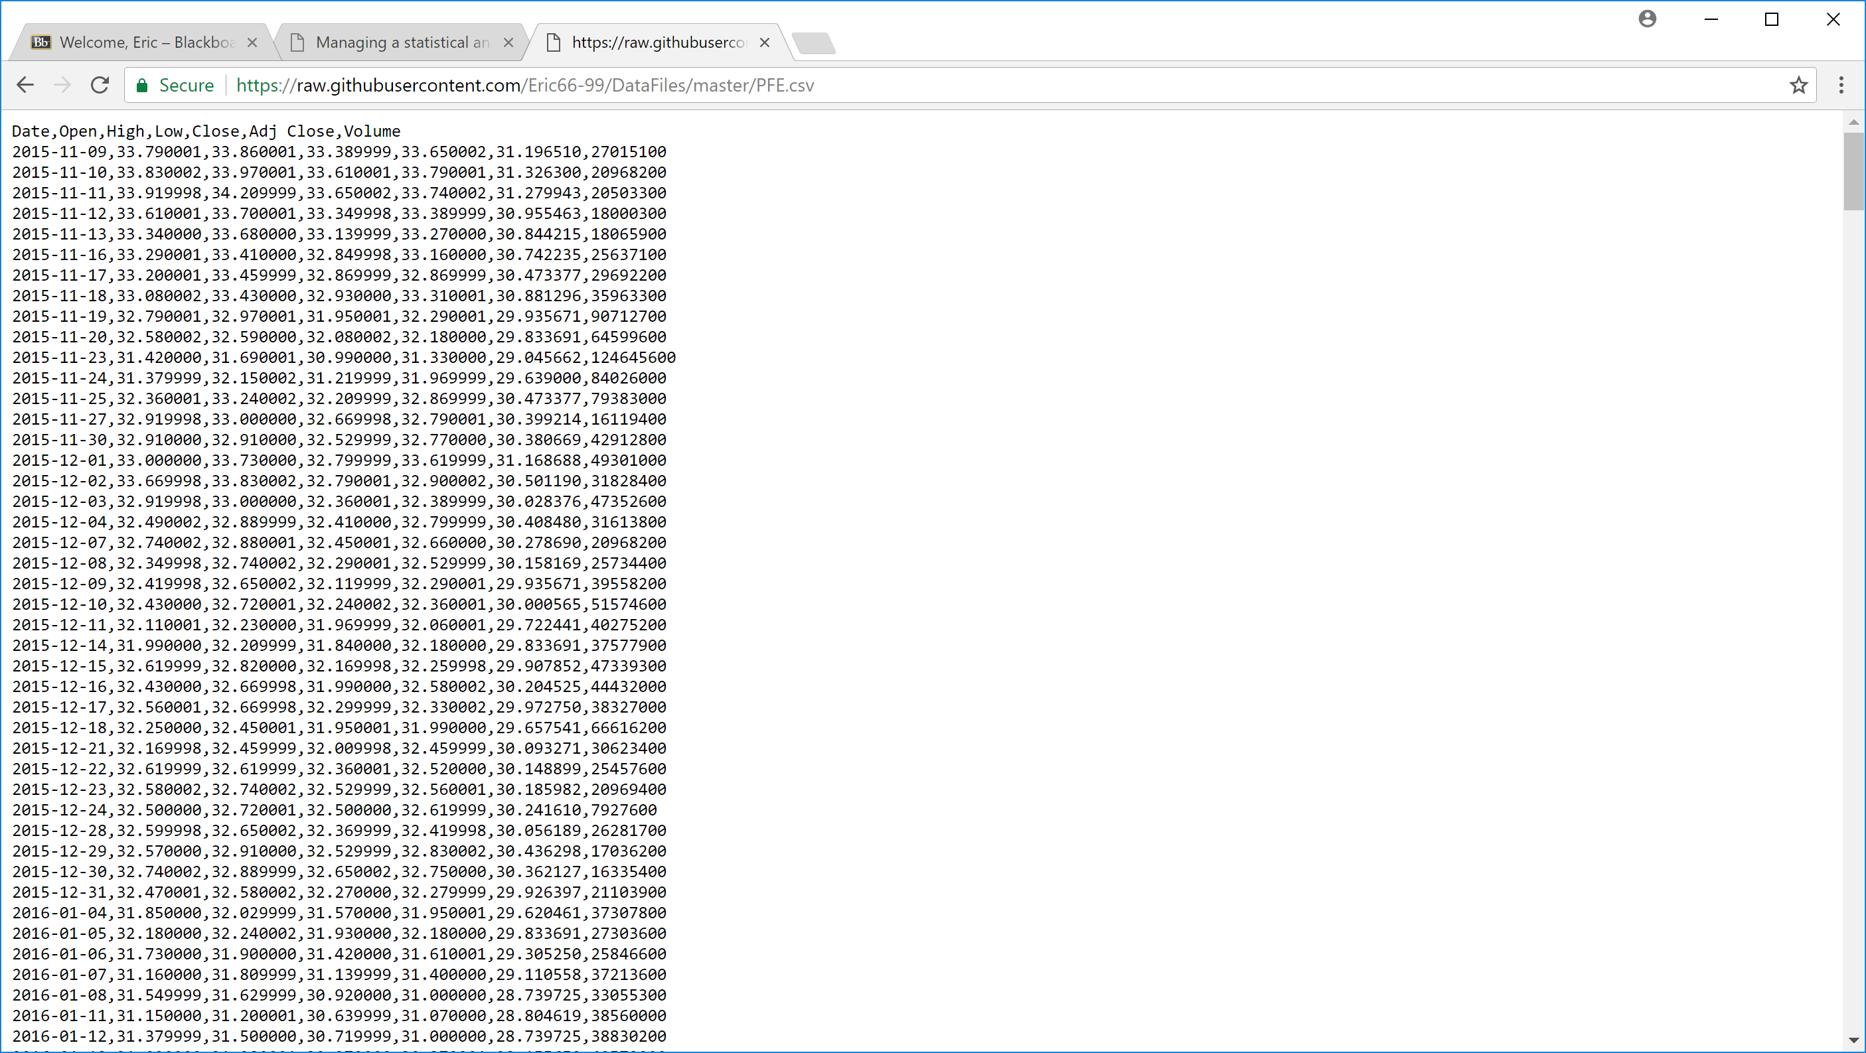
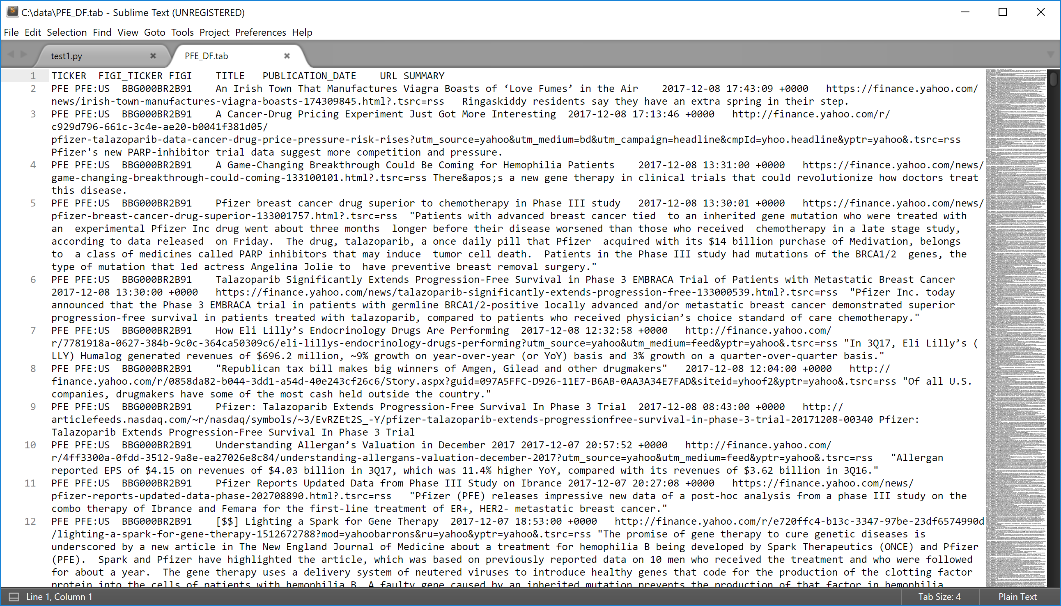
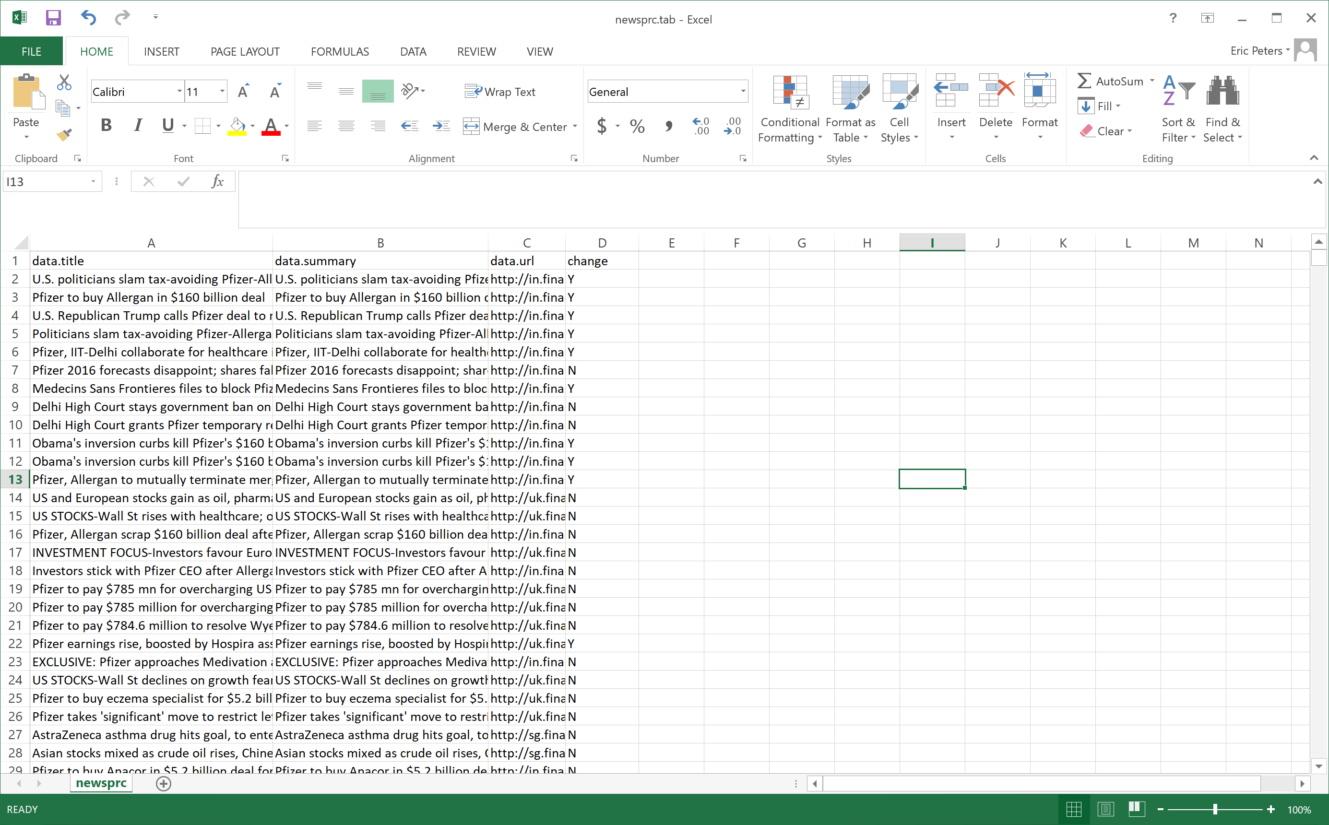
Raw Price data
Raw News Data
“Cleaned” data fed to models

Slide 13
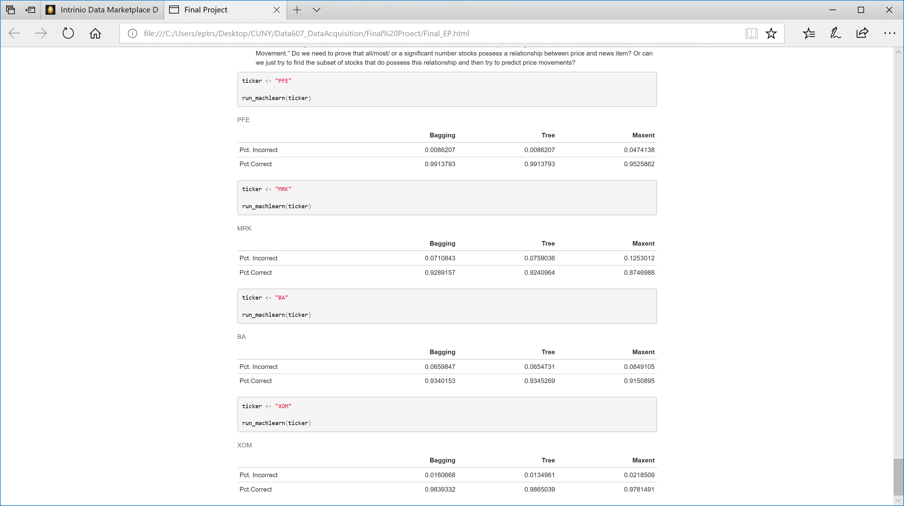

Slide 14
Interpretation and Conclusion

Slide 15



Availability of data

Slide 16
Data quality/ data integrity

Slide 17
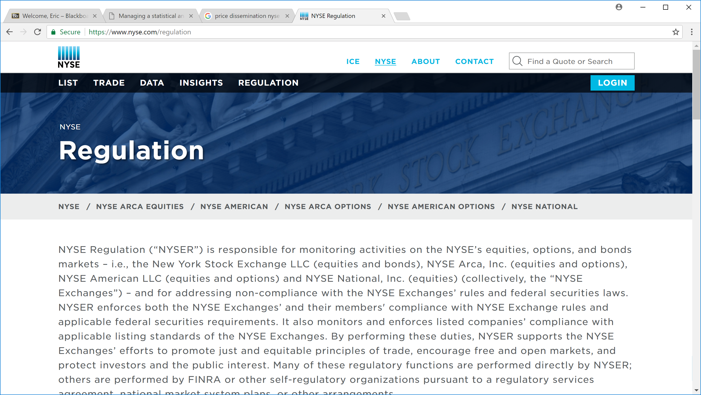
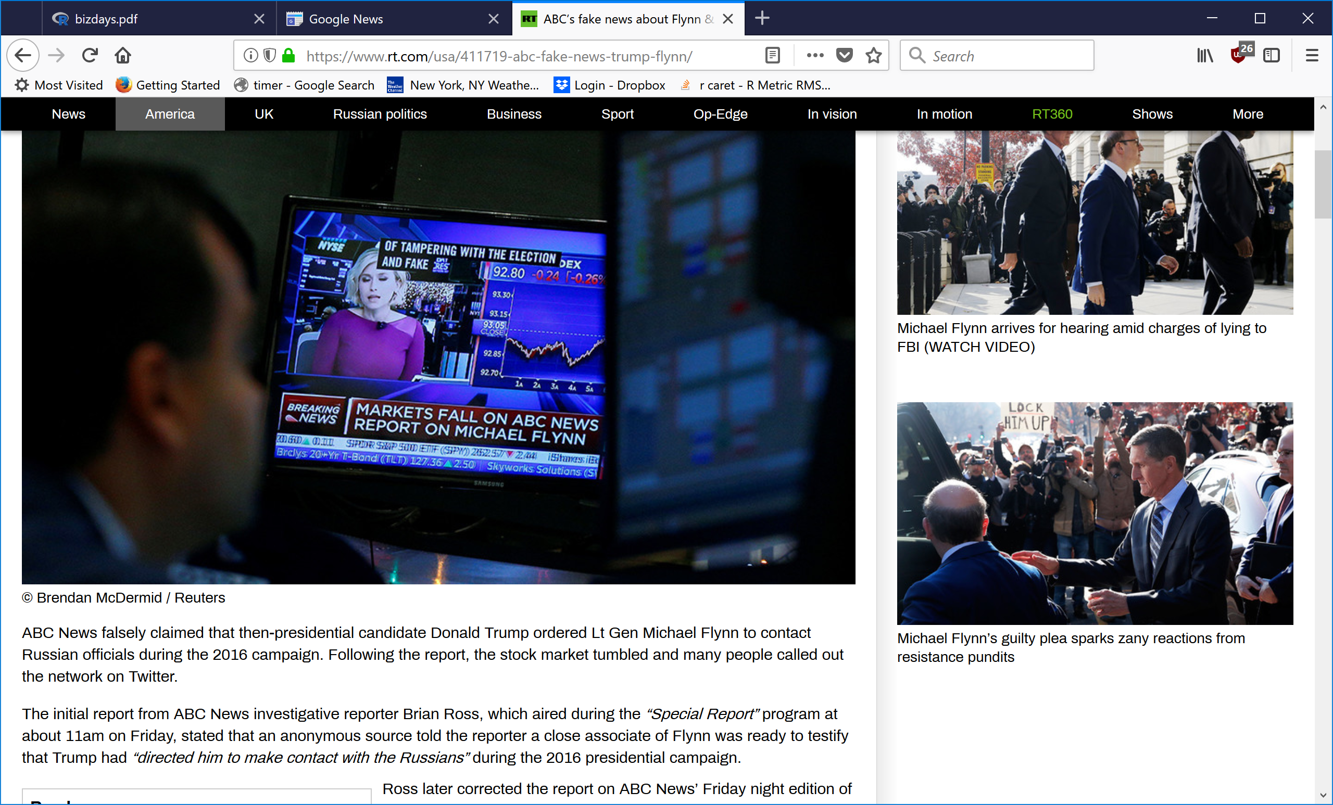
Data quality/ data integrity

